Slide 1
Bit 302 software engineering
Final Refinement
Luh Wulandari Maharani (E1700873)
Rivaldo Bagus Soepardhy (E1700882)

Slide 2
FUNCTIONAL REQUIREMENT
Housing Officer
Login / Logout System
Change / Reset Password
View, Edit, and Delete for Applicant Object
Basic CRUD (Create, Read, Update, Delete) for Application Object
Add, View, and Edit for Residence Object
Add(Allocate), View, and Delete for Allocation Object

Slide 3
FUNCTIONAL REQUIREMENT
Applicant
Login / Logout System
Sign Up
Change / Reset Password
Add(Submit) & View for Application Object
View for Residence Object

Slide 4
NON-FUNCTIONAL REQUIREMENT
Requirement | Description
Security requirement | Using login system, session & framework middleware for authorization to prevent unauthorized access of certain parties.
Usability | The system should be easy to access for Housing Officer and Applicant.
Integrity | Data inside the system will be keep as it is, untampered and unharmed.
Modifiability | Data can only be change by authorized user (Housing Officer).

Slide 5
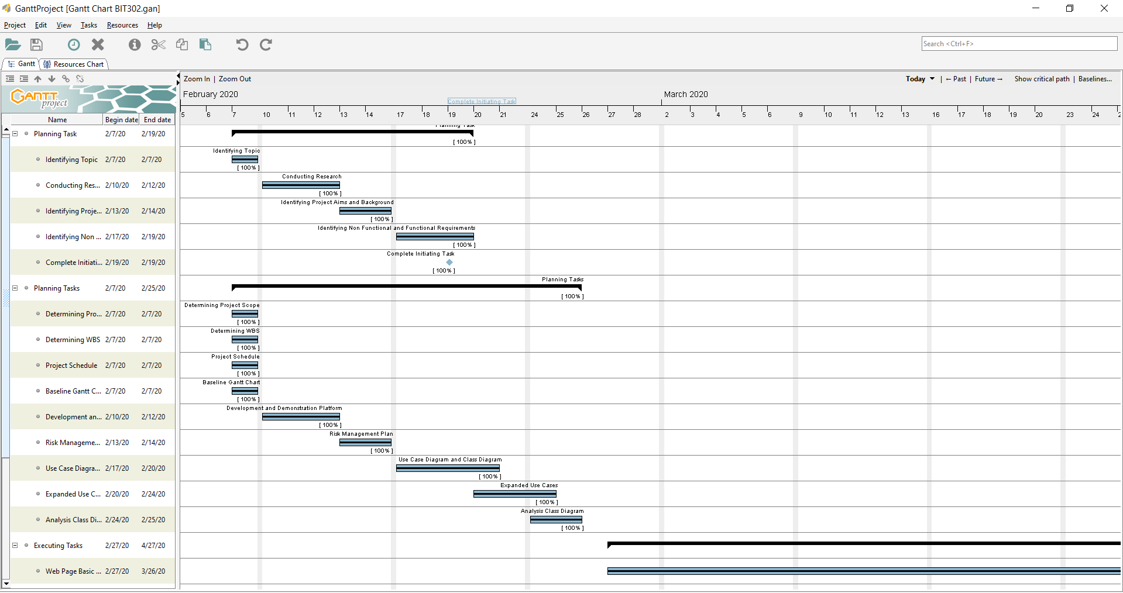
Gantt Chart

Slide 6
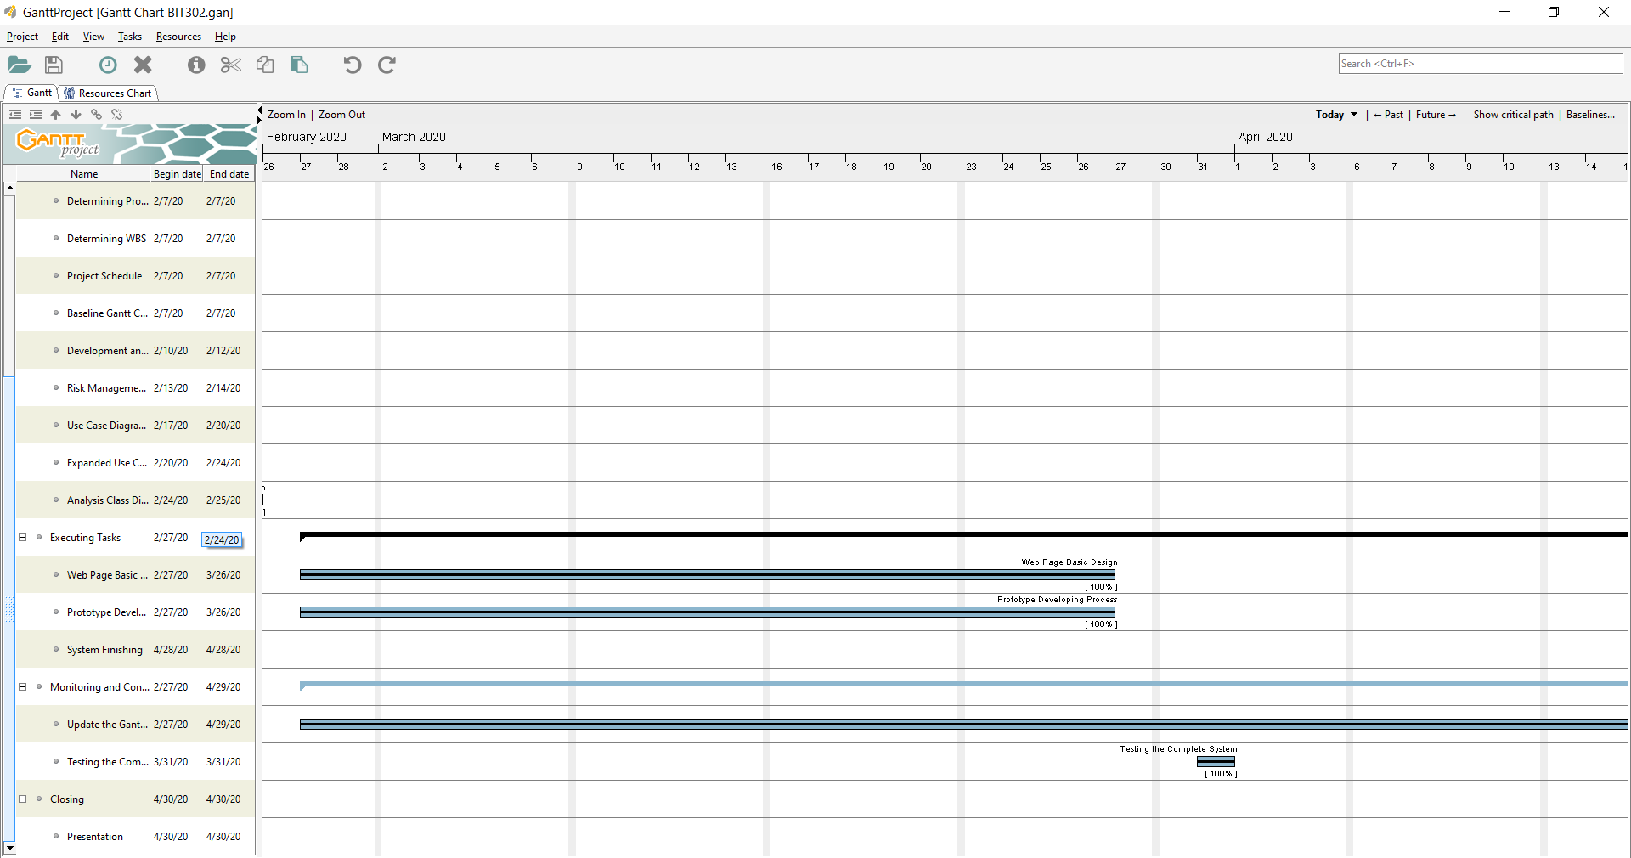
Gantt Chart

Slide 7
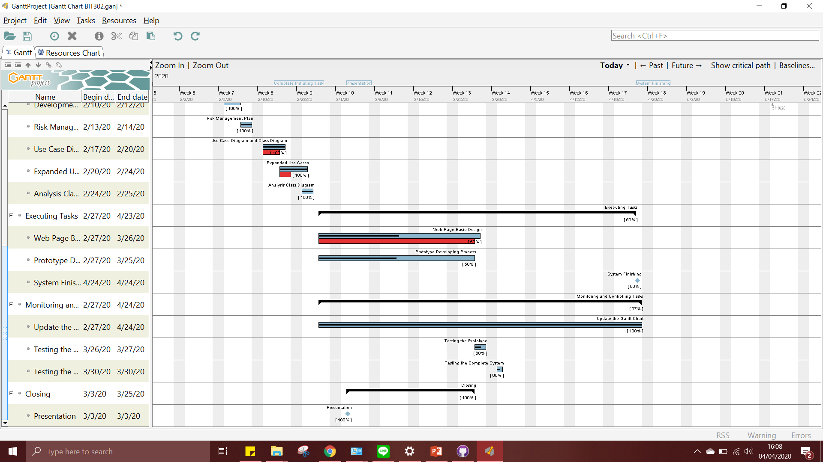
Baseline Gantt Chart

Slide 8
Updated Use Case
Remaining Use Case | Testing
Change Password (HousingOfficer) | Iteration 2
Change Password (Applicant) | Iteration 2
Delete Application (HousingOfficer) | Iteration 2
Edit Application (HousingOfficer) | Iteration 2
View Allocation (HousingOfficer) | Iteration 2
View Allocation (Applicant) | Iteration 2
Allocate Housing(HousingOfficer) | Iteration 2
Delete Allocation(HousingOfficer) | Iteration 2
View Applicant(HousingOfficer) | Iteration 2
Edit Applicant(HousingOfficer) | Iteration 2
Delete Applicant(HousingOfficer) | Iteration 2
View Housing Officer (HousingOfficer) | Iteration 2

Slide 9
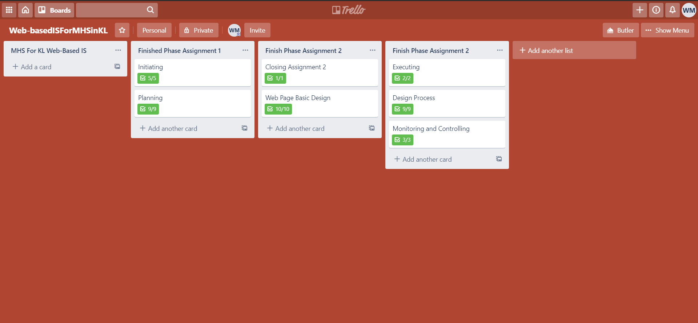
Trello

Slide 10
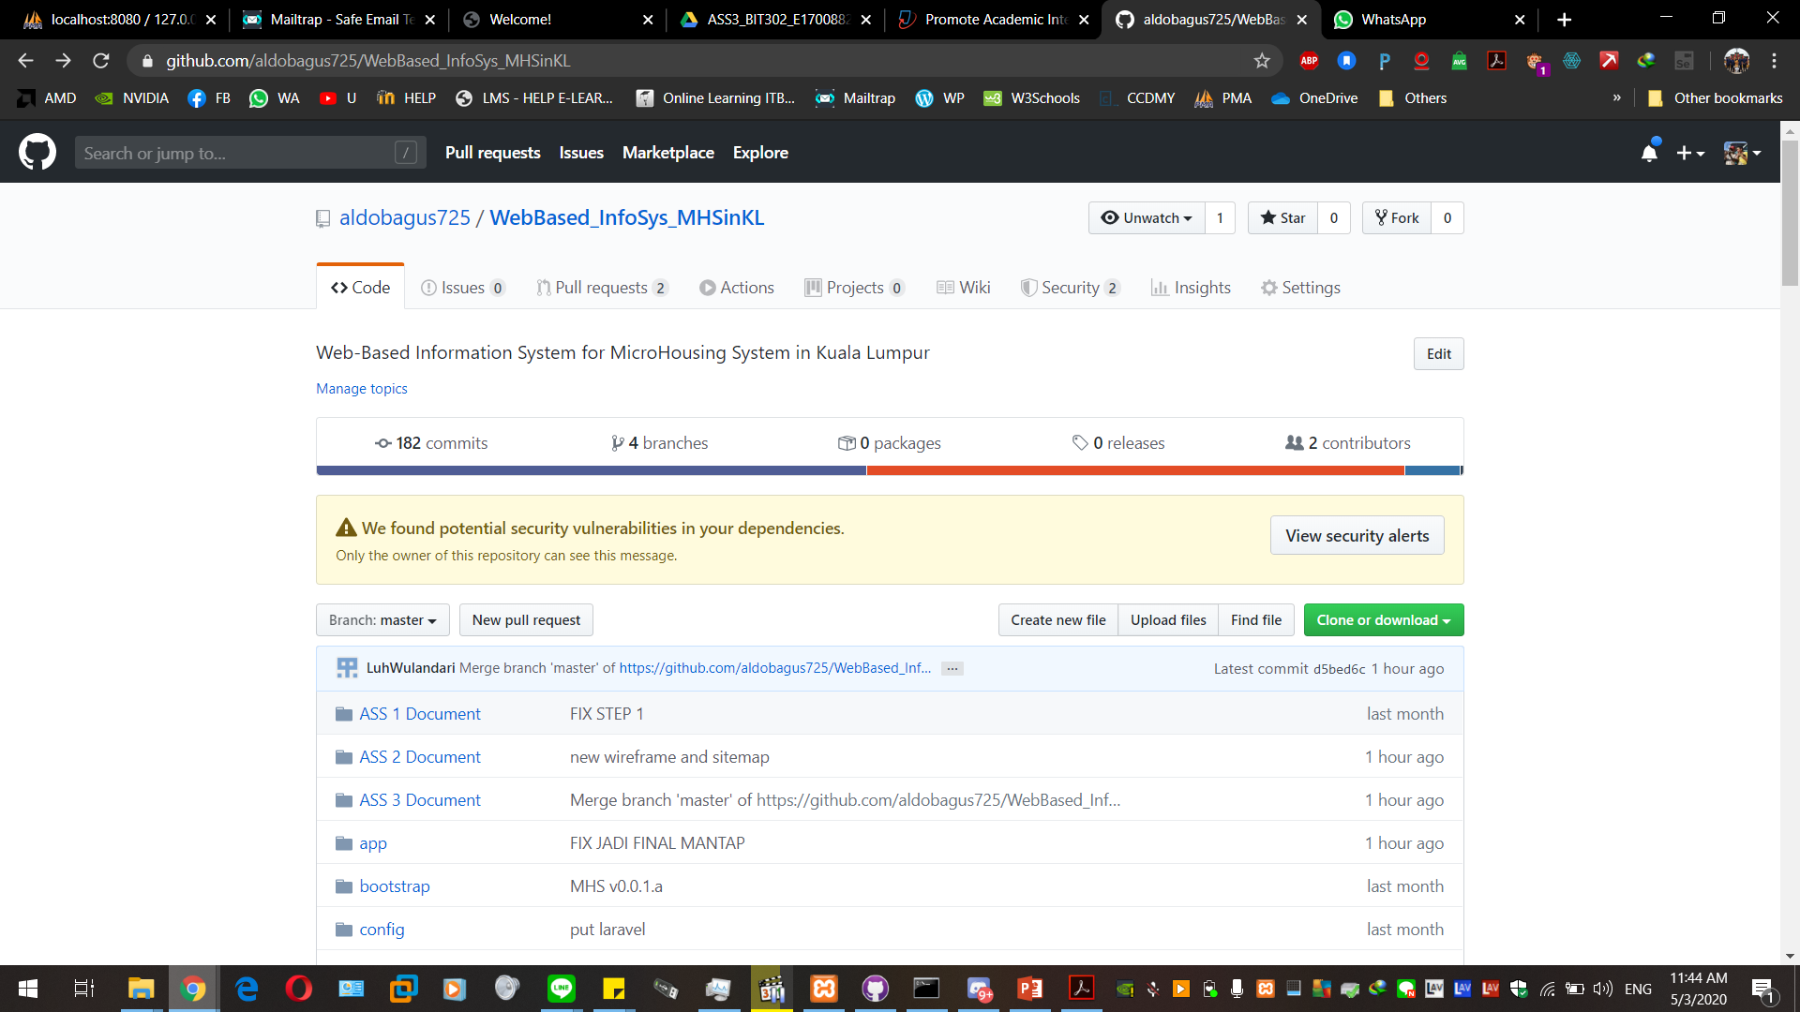

Slide 11
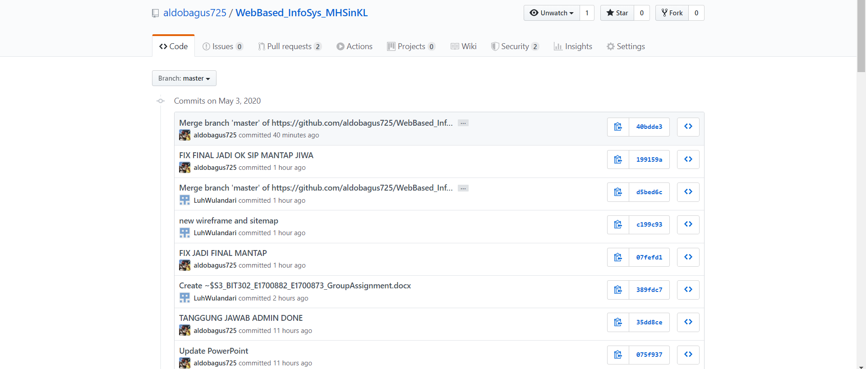

Slide 12
